Slide 1

STRATIFIED RANDOM SAMPLING (Bankruptcy Prediction-case)
A Method of Sampling
Notes:
Previously, there was a brief explanation about the differences between random sampling and stratified random sampling (SRS).
And here, we focus on SRS material.

Slide 2

OUTLINE
Introduction to Bankruptcy Prediction
Introduction to Stratified Random Sampling
Example of Stratified Random Sampling
Steps to Find Match Pair Companies using Stratified Random Sampling
Notes:
This is the outline for stratified random sampling material.
1. Since we apply the stratified random sampling on bankruptcy prediction case, then Firstly, I will introduce bankruptcy prediction
2. Secondly, we will explain why we select SRS for bankruptcy prediction case then introduce SRS itself
3. Lastly, we present the example and step by step when applying SRS

Slide 3



Bankruptcy Prediction
Invest $100
Normal Company: profits
Bankrupt Company: losses (lost $100 money even paying again so that company not bankrupt)
Bankrupt company predicted accurately, investor can take back the money.
Notes:
First, We introduce the bankruptcy prediction case.
Predicting bankruptcy is a binary classification to predict whether the company is predicted as normal/good or bankrupt.
This is the illustration of a bankruptcy prediction case: as an investor, if we invest a lot of money in a normal/good company, in the future, we get profit.
Otherwise, we will lose money when we don't know whether the company we invested in will be bankrupt next year.
So predicting bankruptcy is important because investors can take back their money earlier and prevent economic loss if they know that next year the company is predicted to be bankrupt

Slide 4
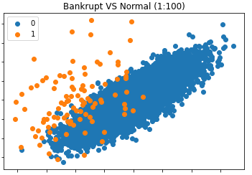

Company Distribution
N
B
Real World Case
(1:1000++)
Investor
A company Bankrupt/Not
Trading: Buy the Company
Sell the Company
We need specific sample
Notes:
Next, is why we select SRS for predicting bankruptcy cases?
This is the real world company distribution where the bankrupt company which is represented by orange plot and normal company which is represented by blue plot.
According to this picture, we can see that the ratio of bankrupt and normal companies is imbalance. Some studies state the ratio is 1:1000 or 1:100 and so on.
Because of this huge ratio, as an investor, predicting a company that goes bankrupt is sometimes a difficult task. This will leave them confused as to whether they need to sell/buy the company's shares when they invest or trade.
Of course, if they know that the company is going to be bankrupt, they will sell the company’s shares to save their money.
So, in this case, how do investors know the company will go bankrupt while recalling the distribution of the company, the number of normal companies is greater than bankrupt companies?
So we need specific samples of which one is really going bankrupt and which one is really normal to learn how to distinguish these samples.

Slide 5
Learning Objective
Bankruptcy prediction models developed on a specific sample can only be applied to the companies with the same characteristic
Implement stratified random sampling for matching pairs company
Notes:
Therefore, for the bankruptcy prediction case, the model developed on a specific sample (bankrupt sample and normal sample) which has the same characteristic, so that we can distinguish the difference between these two classes (bankrupt and normal).
To achieve that goal, the suitable technique to get the sample is using stratified random sampling for matching pairs.

Slide 6
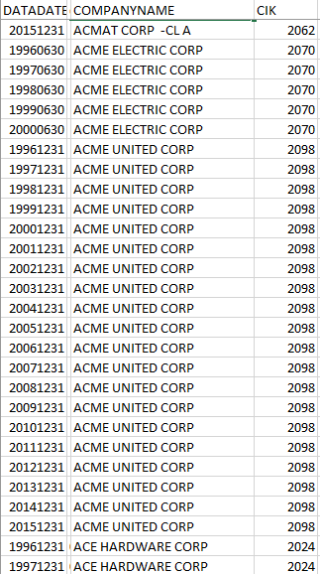
RS vs SRS - Bankruptcy Prediction Case?
Random Sampling Stratified Random Sampling (No Constraints) (Apply Constraints)
Imbalanced Data → Too much normal company
Imbalanced Data → Balanced normal-bankrupt company
N
B
Real World Case
(1:1000++)
Bankrupt Database | 1 Bankrupt company → 1 data on specific bankrupt year
Normal Database | 1 Normal Company → Many data since the company started up (20++ years = 20++ information)
1 Normal Company: 19 information
Notes:
Here we provide the difference between random sampling and stratified random sampling for bankruptcy prediction cases.
The main differences between both techniques are applying constraints and not. For random sampling, there are no constraints while stratified random sampling, the constraints are applied.
According to the imbalanced data of bankrupt and normal companies, there will be too many normal companies.
→ We recall again the illustration of bankrupt and normal companies. Number of normal companies is larger than bankrupt ones
So, if we apply random sampling, there are too many differences between bankrupt and normal companies. Moreover, a company's condition (bankrupt or normal) is affected by many factors such as the financial health of the company that are represented by financial ratios and environmental factors such as macroeconomic conditions, and so on. Therefore, distinguishing the bankrupt and normal companies will be a difficult task due to those various factors that cause too many different characteristics of bankrupt and normal companies.
Meanwhile, if we apply SRS, we will make this imbalanced data to be balanced because we will fetch bankrupt and normal companies which have the same characteristics. In addition, applying constraints in SRS can reduce the diversity characteristics of bankrupt and normal companies. In statistics, applying constraints in the experiment is similar to the control variables. The variables are held constant in order to examine the relationship between several variables.
In a bankrupt database, for each bankrupt company there is one data on a specific bankrupt year
Meanwhile, in a normal database. For each normal company there are many data since the company started up
This is an example of data from a company.
For example, the ACME company. If the company goes bankrupt in 2016, then only the data of 2015 will be used for a bankrupt company while the data from 2016 to 2014 (19 datas) are data for normal companies. This is the real example that illustrates imbalanced data of bankrupt and normal companies. The number of normal companies is larger than bankrupt companies.

Slide 7
RS vs SRS - Bankruptcy Prediction Case?
Random Sampling Stratified Random Sampling (No Constraints) (Apply Constraints)
Imbalanced Data → Too much normal company
Representative Data → Bankrupt and Normal company tends to have different characteristic (not fair): - Bad economy in specific year; - Distress on one category of industry type only i.e. agriculture - Big/Small company
Imbalanced Data → Balanced normal-bankrupt company
Representative Data → Strata (constraints/Control variables): Bankrupt and Normal company has the same characteristics
2005
2013
Bankrupt
Normal
Bad economic
Good and bad economic
Agriculture - Drought
Weather is good and bad
Notes:
Next, according to the representative data.
If we use random sampling then the bankrupt and normal companies tend to have many different characteristics because we pick the normal company randomly. So comparing bankrupt and normal companies will not be fair.
While SRS uses strata which filter the data according to constraint or in statistics might be known as control variables. Thus, we can generate bankrupt and normal companies which have the same characteristics. Under this same condition, we can distinguish bankrupt and normal companies.
Here are examples if we use random sampling which causes many different characteristics of bankrupt and normal companies:
According to the specific year. As we know, a company becomes bankrupt in a specific year. In addition, every year, the financial health’s company also is affected by the environment factor.
Suppose we picked a bankrupt company in 2005, which in that year, actually the economic condition of the country is bad. Meanwhile, there were many normal companies to be compared which are in bad and good economic conditions. How do we identify the cause of the bankrupt company from that year when they don't have any benchmark comparison? It will be fair, if we have a bankrupt and normal company at the same year. So, under the same conditions of the year, we can learn what makes a company bankrupt while the other not.
According to industry type. Suppose in 2005, we had a bankrupt agriculture type. In that year, the weather is not good and causes dryness. It won’t be fair if we compare a bankrupt company in bad weather to many normal companies in different years which have bad and good weather. So do for comparing big and small company at different year
Meanwhile, SRS uses strata when we apply constraints/control variables. Then we have samples of bankrupt and normal companies that have the same characteristics. According to this similarity, we have a baseline to distinguish bankrupt and normal companies then found what variables that we examine affect the model

Slide 8
Random Sampling in Imbalanced Data set (Bankruptcy Prediction)
 | Number of Company
Normal Company (+) | 10,000
Bankrupt Company (-) | 100
Split the data for 5 round experiment !
Round 1
Round 2
Round 3
Round 4
Round 5
Train
Test
Contain Normal and Bankrupt Company whose different characteristic
Contain Normal and Bankrupt Company whose different characteristic
Notes:
This is the illustration of random sampling which uses imbalance data in bankruptcy prediction cases. The number of normal companies is larger than the bankrupt ones.
When we use random sampling and runs the experiment, then we split the data into training and testing, each train and test dataset consists of bankrupt and normal companies whose too many different characteristics

Slide 9
Stratified Random Sampling (Bankruptcy Prediction)
 | Number of Company
Normal Company (+) | 183
Bankrupt Company (-) | 183
Split the data for 5 round experiment !
Round 1
Round 2
Round 3
Round 4
Round 5
Train
Test
Contain Normal and Bankrupt Company whose same characteristic
Contain Normal and Bankrupt Company whose same characteristic
Notes:
But, if we use SRS the data is balanced, and the training and testing dataset consist of bankrupt and normal companies whose same characteristics (filtering the companies according to the control variables)
Using this kind of data to run experiments, the classifier can learn to distinguish bankrupt and normal companies despite of the impact of the control variables

Slide 10
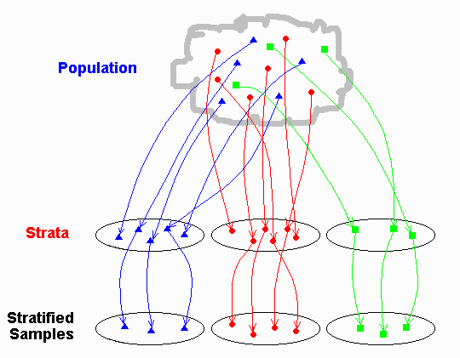
What is Stratified Random Sample ?
A stratified random sample is a population sample that requires the population to be divided into smaller groups, called 'strata‘
Notes:
So, what is SRS itself?
A stratified random sample is a population sample that requires the population to be divided into smaller groups, called 'strata‘
Strata here, we filter using some constraints or we can say as the control variables. Then we only fetch some the result which we call as stratified sample
For instance, observe how the results of a study could be influenced by the subjects’ attributes, such as their ages, gender, work experience level. These attributes are the constraints that we are talking about

Slide 11









Example Stratified Random Sampling
Stratum constraint : Age <50
STRATA
Stratum constraint:
work experience < 5 years
SAMPLE
Strata constraint : gender
POPULATION
Stratum constraint:
work experience < 5 years
Stratum constraint : Age <50
Notes:
How are steps to Perform Stratified Random Sampling?
Here we provide an example, we want to observe how the results of a study could be influenced by the subjects’ attributes, such as their gender, ages, work experience level
Here we have a population that consists of many people that have different gender, ages, and work experience level background.
Then we want a specific sample in our dataset. So we split the data according to the first constraint i.e. gender. These two groups that we call as strata.
Then to get a more specific sample, we filter again according to ages that are less than 50 for each strata. And the last constraint is filter according to work experience level that is less than 5 years. After that we fetched some of the results to be the final sample

Slide 12



Stratified Random Sampling for Matching Pairs Data
Stratified random sampling can be used to do matching pairs in order to get the suitable pairs.
Example: A pair of bankrupt and normal company
The sample dataset contains pairs of companies : Bankrupt and normal.
To find the matched pairs, we need to applied certain constraints : Datadate (Year of annual report), SIC (Industry Classification), and Total Assets.
Stratified Random Sampling
Datadate, SIC, and Total Assets.
Find Match Pair
Result
(stratified random sampling)
A Bankrupt Company
(1027)
Paired Company
(183 Bankrupt Company; 183 Normal Company)
Normal Companies
(255876)
Notes:
This SRS technique is applied in our experiment to find the matching pairs of our data.
Stratified random sampling can be used to do matching pairs in order to get the suitable pairs.
In our case, we want to pair a bankrupt company with a normal company. Because our sample dataset contains pairs of companies, bankrupt and normal
To find the matched pairs, we need to applied certain constraints : Datadate (Year of annual report), SIC (Industry Classification), and Total Assets
Here we have an illustration of the matching process. There are 1027 bankrupt companies in the bankruptcy database. Then for each bankrupt company, find the matching pair. As you know, the number of normal companies is larger than bankrupt ones. In here, there are more than 200 thousand normal companies. According to these constraints, we only obtain 183 pairs.

Slide 13
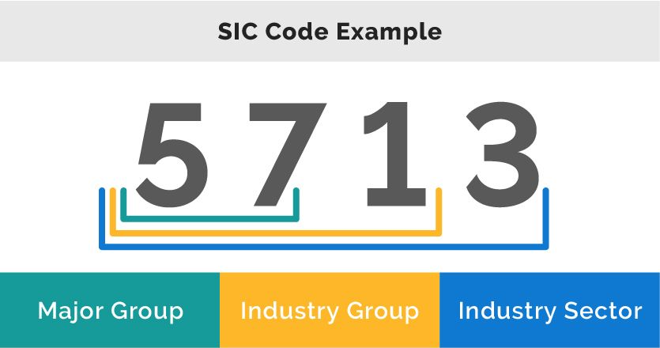
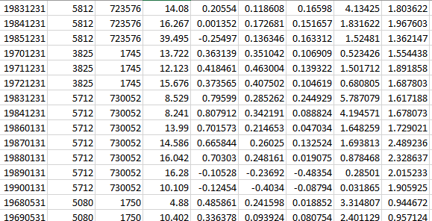
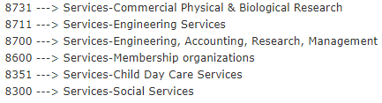
One to one matching constraints :
1. DATADATE: Same Year of annual report
2. SIC(Standard Industrial Classification): Same Industry Type first 3 digits
The difference of industries makes the comparison between different industries become impossible
3. AT (Asset Total) is the closest
Total Asset represents monetary condition of the company
Datadate
SIC
CIK
TA
Notes:
This is the constraints or rule that we applied for the matching process of one bankrupt to one normal company.
Datadate (year of annual report, year refers to a year before the bankrupt year). In this case, we want to find normal companies at the same year to take into account the same year condition
Same industry type. If we compare bankrupt and normal companies in different industries, it becomes inappropriate. For example, we compare the mining industry to the retail industry.
The closest Total asset. Total assets represent the monetary condition of the company and size of the company. For example, it would be appropriate to compare a small bankrupt company to the small normal companies.
These constraints generate specific bankrupt and normal samples and help reducing the bias of the model, so that we can examine which other variables that can distinguish bankrupt and normal com

Slide 14
Steps to Find Match Pair Companies
Provided data of a bankrupt company as below :
Company Name | Datadate | SIC | AT
POWERWAVE TECHNOLOGIES, INC. | 31/12/2011 | 3663 | 342.33
We are going to find 1 of normal company from a set of normal companies, which match to the bankrupt company above, by applying constrains.
The set of normal companies as given below :
Company Name | Datadate | SIC | AT
VIEWCAST.COM INC | 31/06/2011 | 3663 | 604.2
WAVECOM SA | 31/12/2001 | 3663 | 231.379
TELESTONE TECHNOLOGIES CORP | 31/03/2011 | 3663 | 339.238
OMNICELL INC | 31/12/2011 | 7373 | 343.224
Notes:
We provide an example the steps to find the matched pair company
This the bankrupt company information including its datadate, SIC code, and total asset
The goal is finding 1 normal company among set of normal companies by applying those three constraints

Slide 15
Steps to Find Match Pair
Company Name | Datadate | SIC | AT
POWERWAVE T., INC. | 31/12/2011 | 3663 | 342.33
1. Find the companies which have the same datadate
Company Name | Datadate | SIC | AT
VIEWCAST.COM INC | 31/06/2011 | 3663 | 604.2
TELESTONE TECHNOLOGIES CORP | 31/03/2011 | 3663 | 339.238
OMNICELL INC | 31/12/2011 | 7373 | 343.224
Deleted (√)
√
Deleted, it doesn’t has same SIC
2. Find the companies which have the same SIC from the set of companies in the same datadate
∆AT = |AT Normal Company – AT Bankrupt Company|
Company Name | Datadate | SIC | AT
VIEWCAST.COM INC | 31/06/2011 | 3663 | 604.2
TELESTONE TECHNOLOGIES CORP | 31/03/2011 | 3663 | 339.238
∆AT | Deleted (√)
261.87 | √
3.092
Deleted, it doesn’t has the closest AT
3. Find the companies which have the closest AT from the set of companies in the same datadate and same SIC
Company Name | Datadate | SIC | AT
TELESTONE TECHNOLOGIES CORP | 31/03/2011 | 3663 | 339.238
Notes:
This is the bankrupt company,
The first step is to find which normal companies have the same datadate (year). From 4 provided normal companies on the previous pages, we find that only 3 normal companies have the same year: 2011
Next step is to find normal companies that have the same first 3 digit SIC. The SIC of the bankrupt company is 366, so from these 3 normal companies, we will delete the last company that has a different SIC. So here are the selected normal companies
Last step is to find the closest TA. Among these two companies, we calculate the difference TA between normal and bankrupt companies. The smaller number represents the closest TA, then we will delete the first company because it has large difference TA with bankrupt company
Then this is the selected normal company as a pair of this bankrupt company.

Slide 16
Steps to Find Match Pair
The matched pair company
Status Company | Company Name | Datadate | SIC | AT
Bankrupt | POWERWAVE TECHNOLOGIES, INC. | 31/12/2011 | 3663 | 342.33
Normal | TELESTONE TECHNOLOGIES CORP | 31/03/2011 | 3663 | 339.238
Satisfy the constraints, so that’s matched properly
Notes:
Here is the final result when we collect the pair of bankrupt and normal companies. As you can see, the normal company satisfies all the constraints. Later on, we can focus on the attribute that we want to examine despite the influence of the constraints.

Slide 17
Conclusion → RS vs SRS?
Random Sampling Stratified Random Sampling (No Constraints) (Apply Constraints)
Imbalanced Data → Too much normal company
Representative Data → Bankrupt and Normal company tends to have different characteristic (not fair): - Bad economy in specific year; - Distress on one category of industry type only i.e. agriculture - Big/Small company
Imbalanced Data → Balanced normal-bankrupt company
Representative Data → Strata: Bankrupt and Normal company has the same characteristics
Notes:
The following table is the comparison of RS and SRS for bankruptcy prediction cases.
By using Random sampling, it generates imbalance data because many normal companies are not filtered according to constraints. RS also will affect unfair comparison due to too many different characteristics of bankrupt and normal companies. Meanwhile, SRS generates the balanced data and same characteristic of bankrupt and normal companies due to the implementation of strata which filter according to the constraints

Slide 18
THANK YOU

